Slide 1


Cigar Galore
Priya Patel
IS 410 | Ostrow | Fall 2020
Database Project - mycompiler.io
Notes:
Final Project Submission: Contains Final Project materials required for the powerpoint submission portion.
Yes. I made the ppt from scratch :)
& No. I did not know anything about cigars before I started this project. Nor do I know SQL, as you can tell by my poorly compiled code.

Slide 2




Table of Contents
I. Business Situation
II. Database Purpose & Requirements
III. Database Development Schedule
IV. ER Diagram
V. EER Diagram
VI. SQL Commands
9 Table Creation & Population
2 Update Statements
8 Select Statements
2 Join Queries w Group By
4 Additional Join Queries
2 Select Statements Incorporated throughout

Slide 3




Business Situation
A new, walk in only, cigar shop is seeking to upgrade their paper inventory and ordering system. They want to partially transition their system to electronic inventory.
Their hard copy business system makes it tedious for the employees to flip through tons of papers to find simple inventory information.
Sometimes, the shop find papers misplaced or damaged. This can lead to deficits or surpluses of products.
1

Slide 4


Database Purpose
The purpose of the project is to create an inventory database for a small cigar shop. It will be used by the owner and employees to track and manage products in order to improve efficiency.
Database Requirements
To do:
-Create Business
Situation
-ER Diagram
-EER Diagram
The database will be able to:
track employees, orders, & inventory
Add delivered orders to the inventory
Find associations between suppliers, inventory, and employees
...
2
Notes:
Notes: The idea here is to create a beginner friendly inventory system. It will include queries and features to implement all of the project requirements. The store will not be taking online orders and has no loyalty program. Therefor, there is no need for a customer section for the database. However, since walk in customers make purchases, the database should account and store the transaction. To update the inventory, the database should be able to account for the sold inventory in the stock quantity. Other database functions like querying and storing employee and supplier information is necessary. It make it easier to reference materials
Since everything is stored in one place.

Slide 5
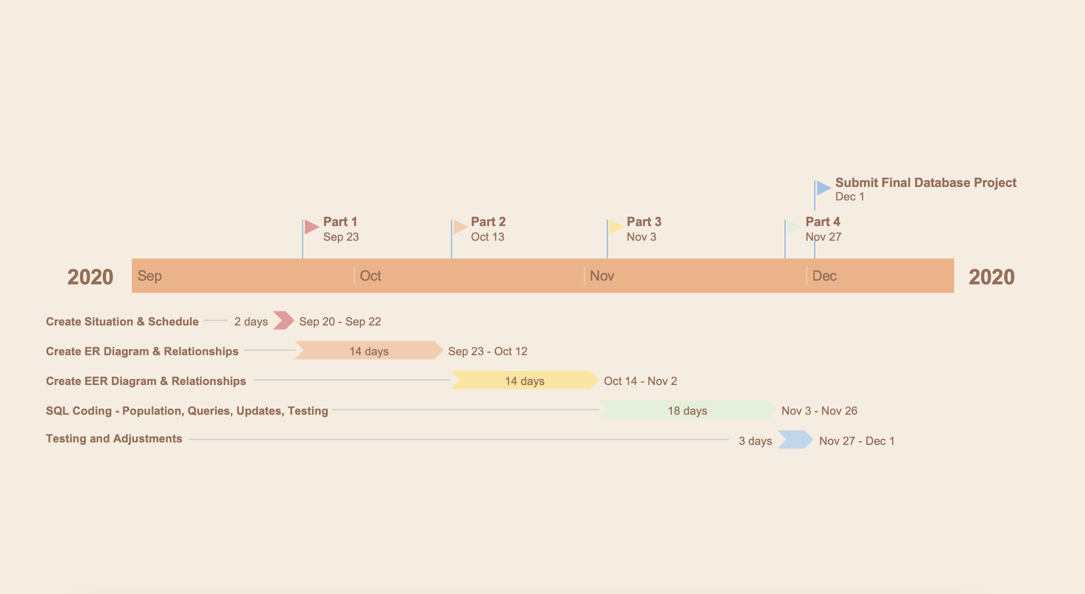
Database Development Schedule
3
Notes:
Notes: As you can see, here is the schedule I created early on for the project development. I feel as though I did a decent job spacing out the four tasks. I do think I could have shortened both the ER diagram and EER diagram task durations to add more time in for the coding phase. All in all, I did stick with the schedule but better scheduling could have been done in hindsight. Regardless, I finished with time to spare.

Slide 6
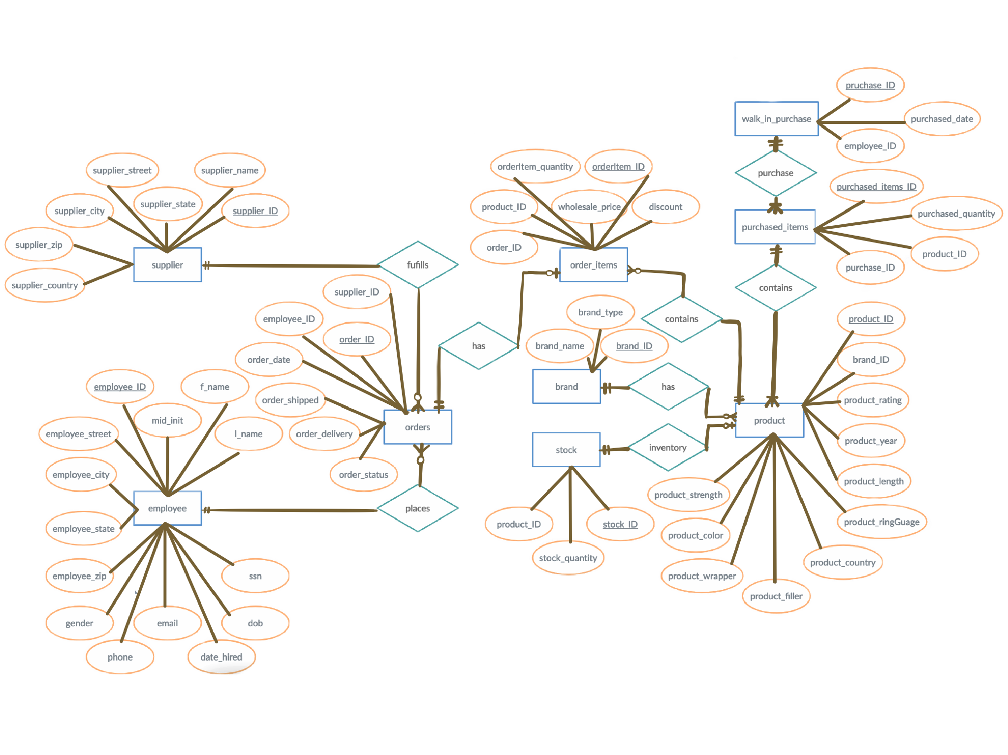
ER Diagram
4

Slide 7
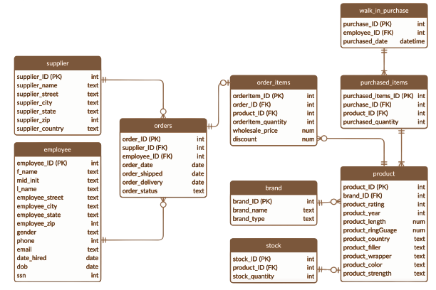
EER Diagram
5

Slide 8
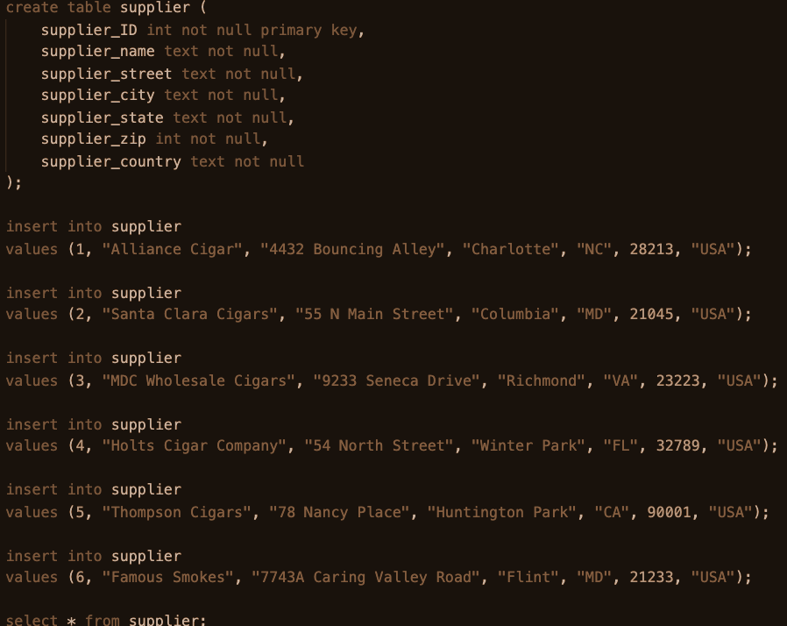
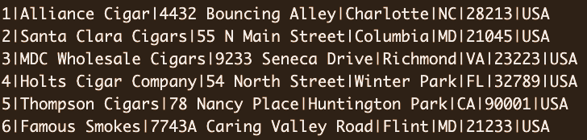
Table Creation & Population 1/9
SQL Commands
6

Slide 9
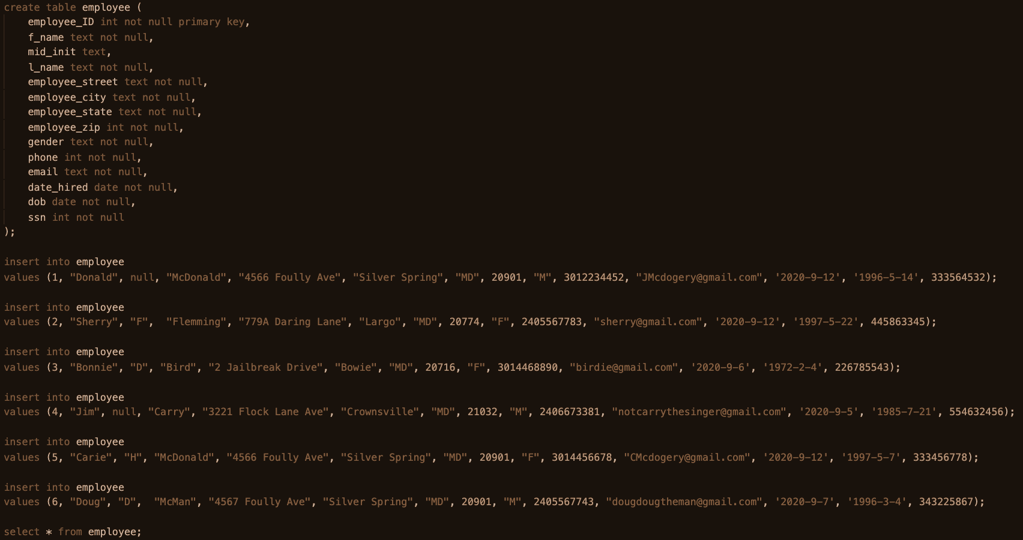
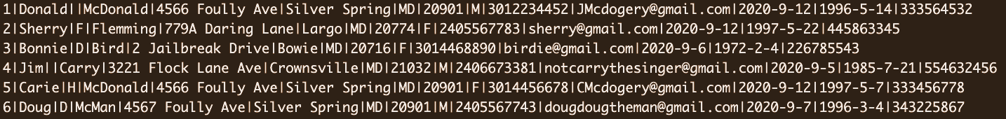
Table Creation & Population 2/9
7

Slide 10
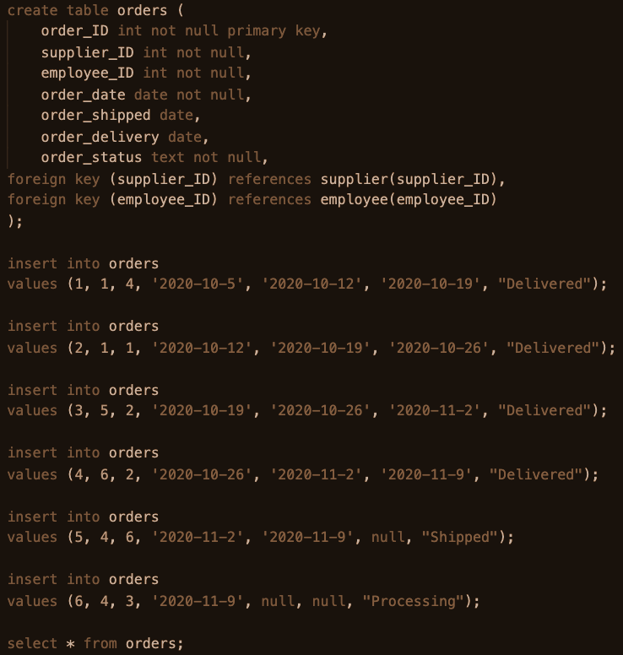
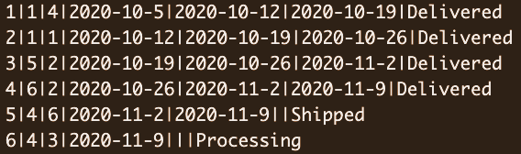
Table Creation & Population 3/9
8

Slide 11
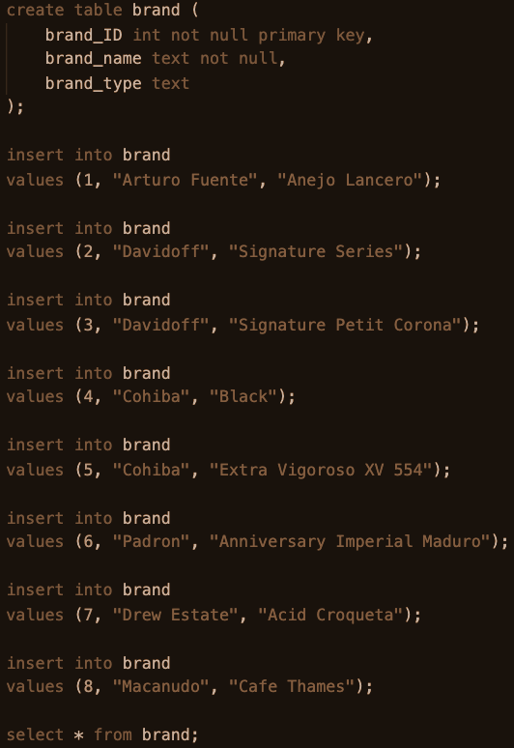
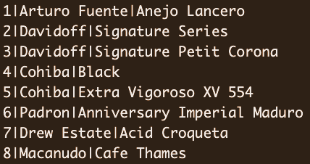
Table Creation & Population 4/9
9

Slide 12
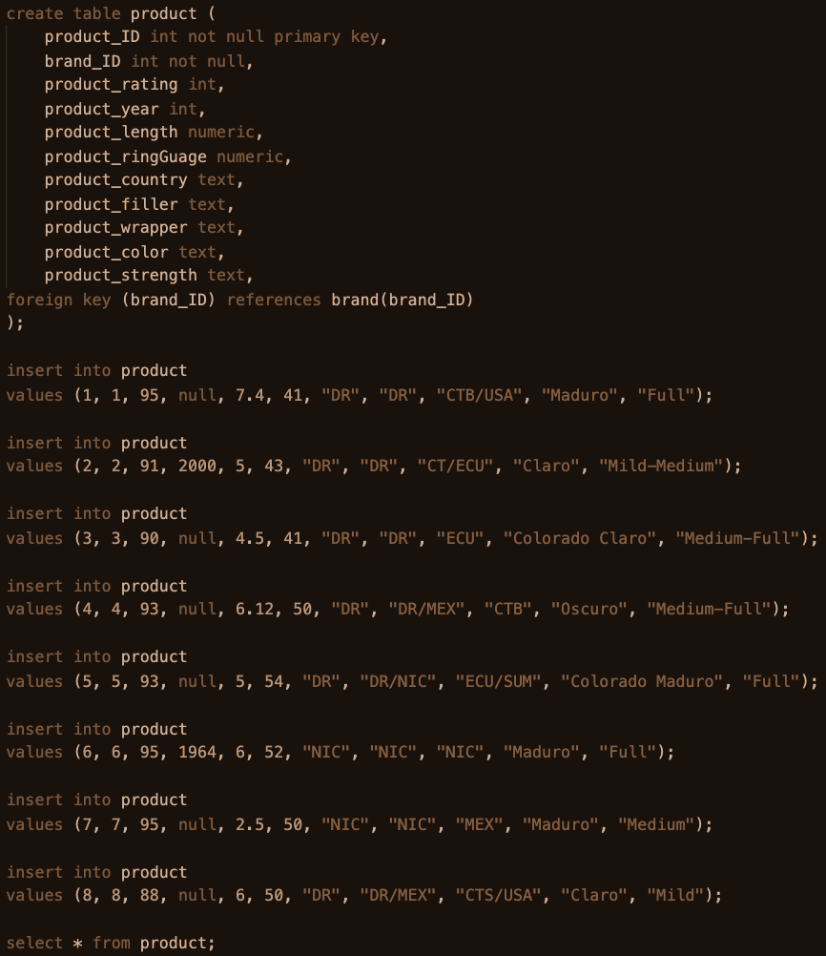
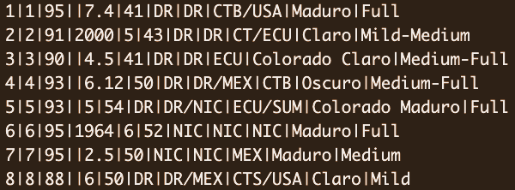
Table Creation & Population 5/9
10

Slide 13
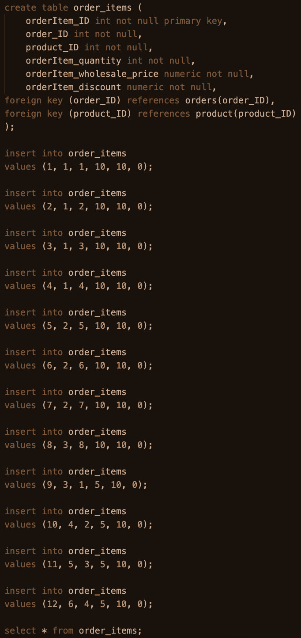
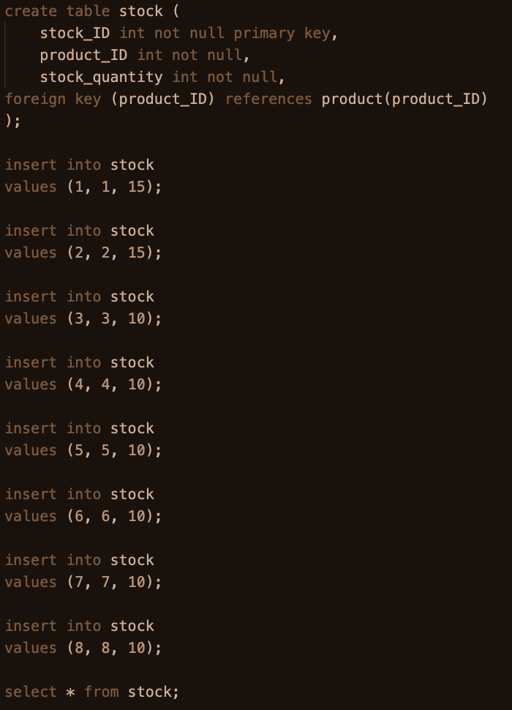
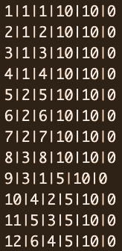
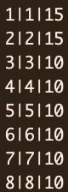
Table Creation & Population 6/9
Table Creation & Population 7/9
11

Slide 14
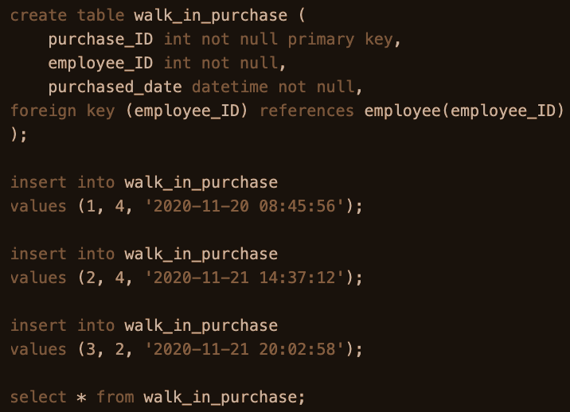
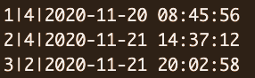
Table Creation & Population 8/9
12

Slide 15
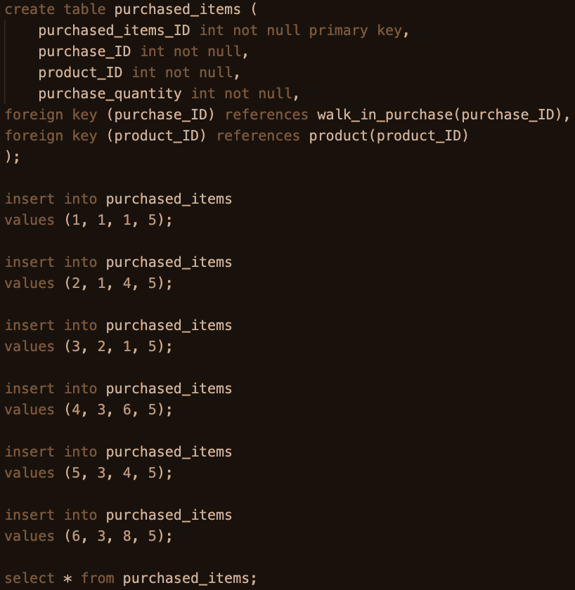
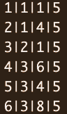
Table Creation & Population 9/9
13

Slide 16
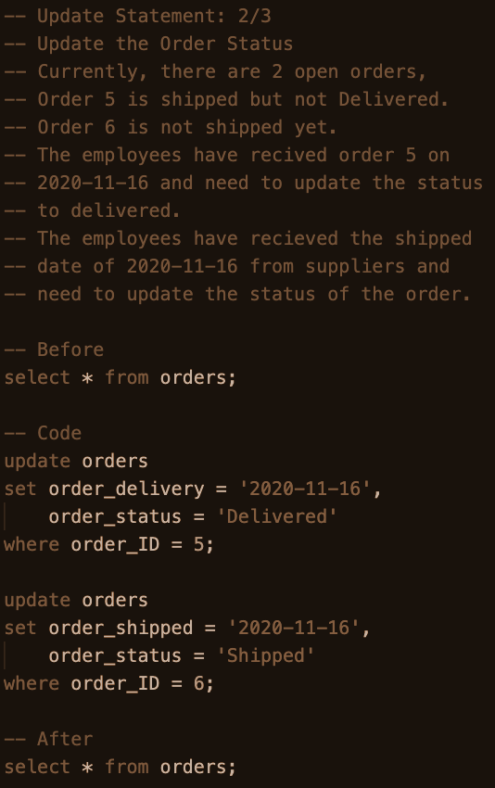
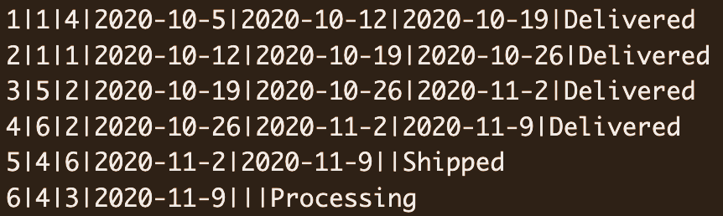
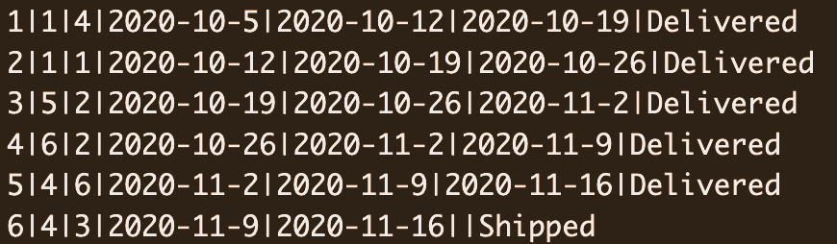
Update Statements 1/2
SQL Commands
Before
After
14

Slide 17
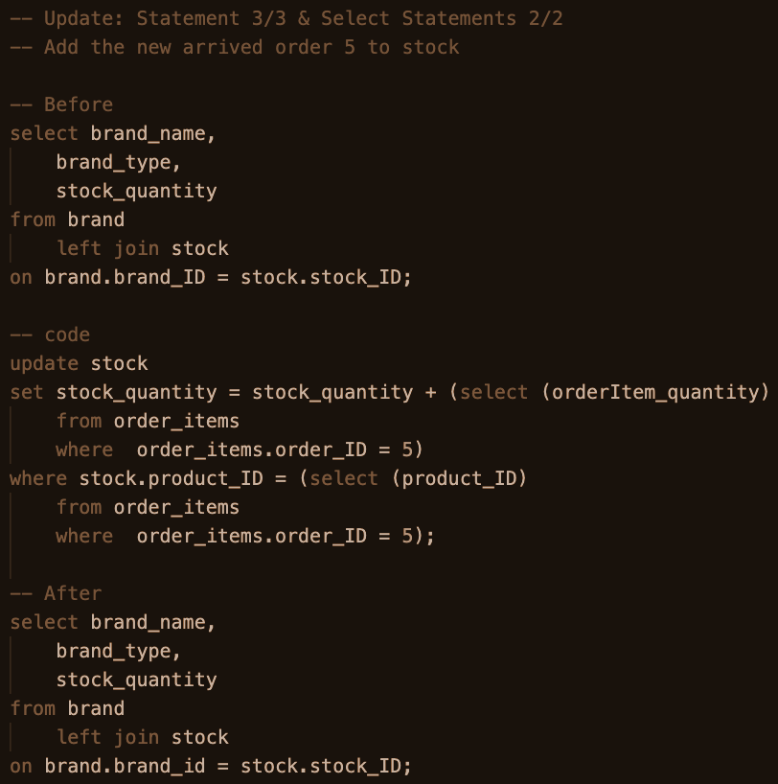
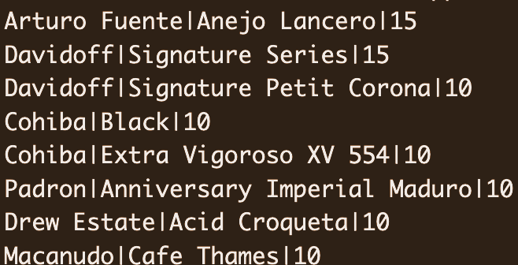
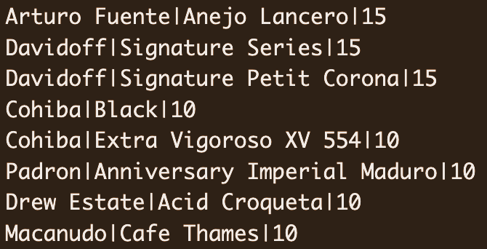
Update Statements 2/2
Before
After
15

Slide 18
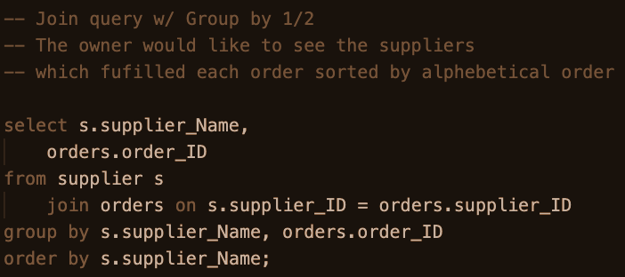
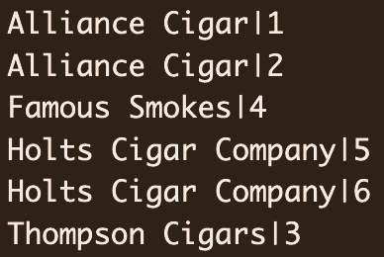
Join Query w Group By 1/2
SQL Commands
16

Slide 19
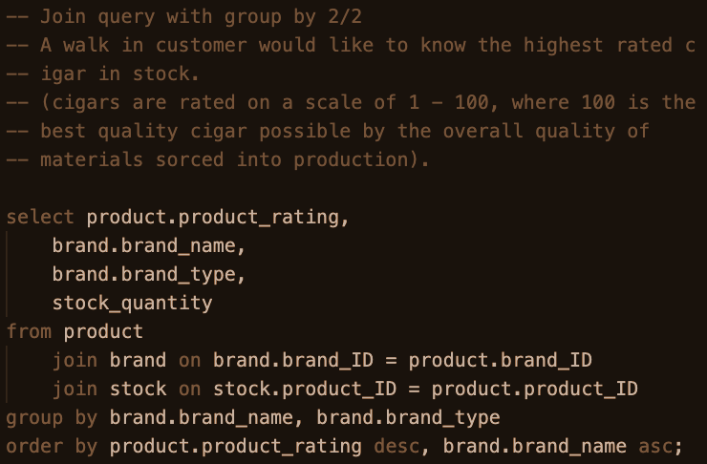
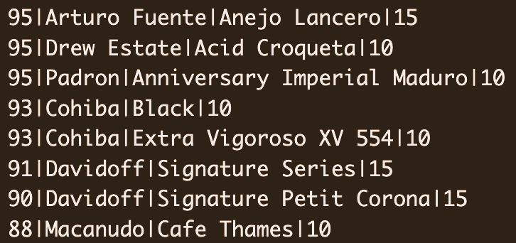
Join Query w Group By 2/2
17

Slide 20
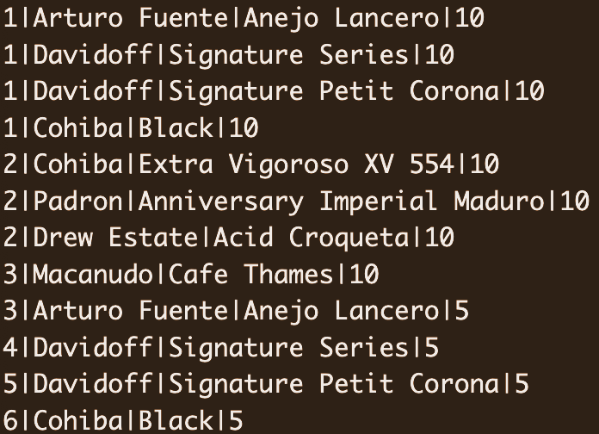
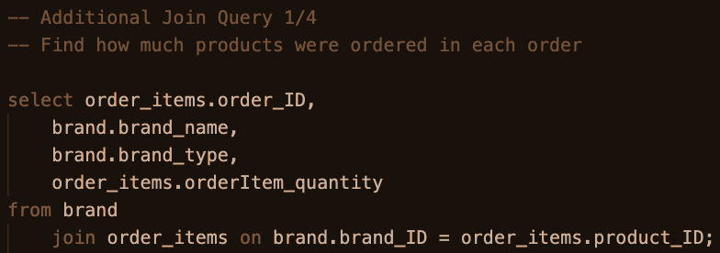
Additional Join Queries 1/4
SQL Commands
18

Slide 21
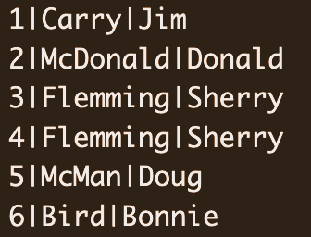
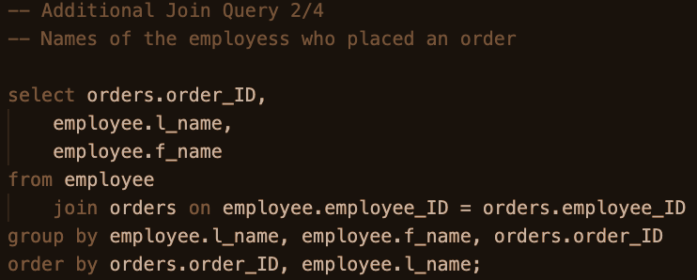
Additional Join Queries 2/4
19

Slide 22
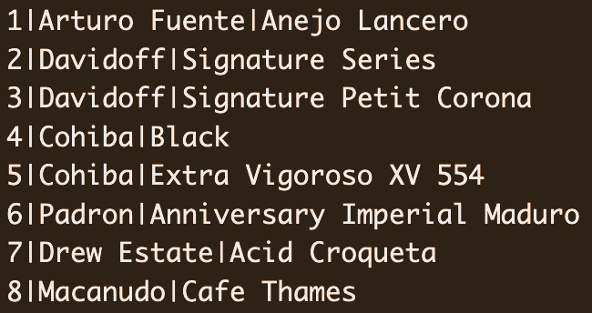
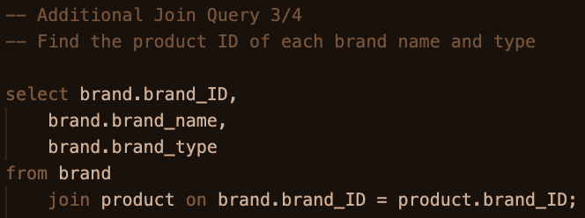
Additional Join Queries 3/4
20

Slide 23
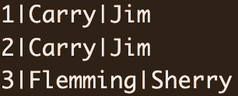
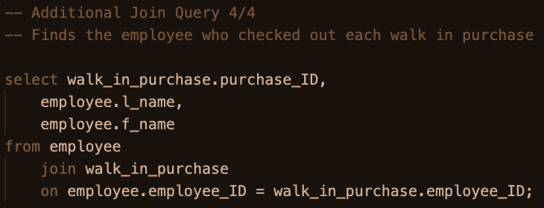
Additional Join Queries 4/4
21

